Slide 1
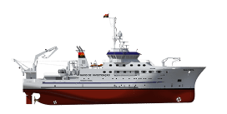
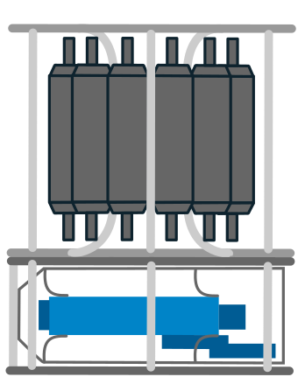
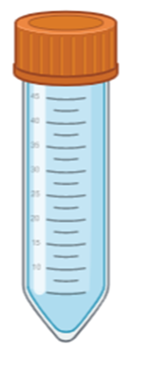
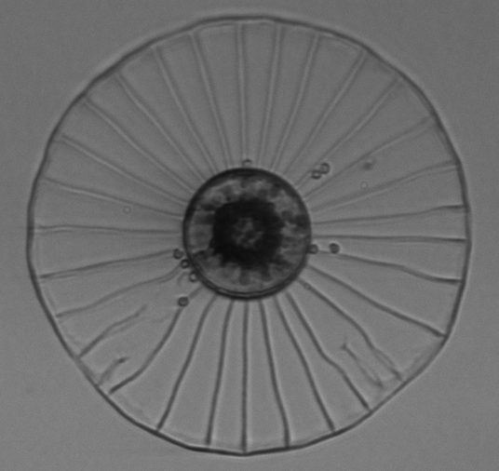
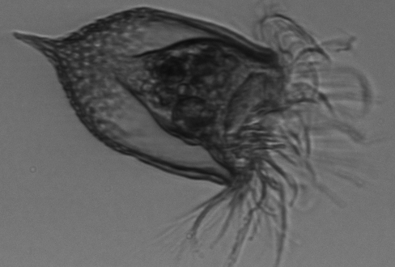
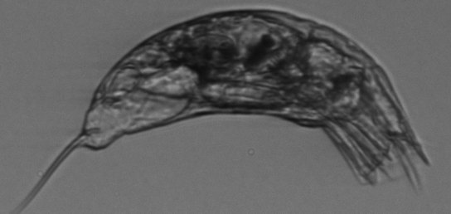
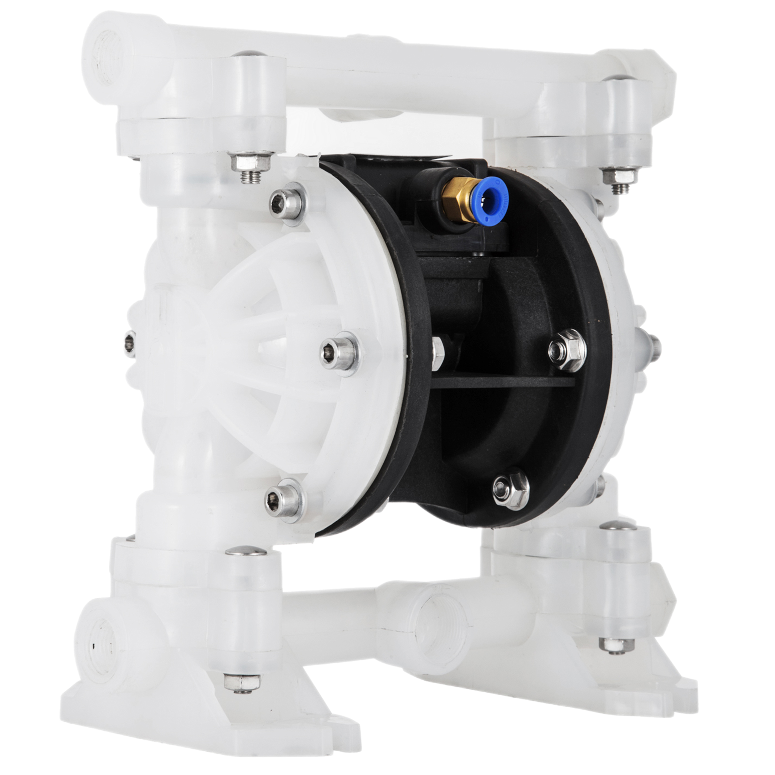
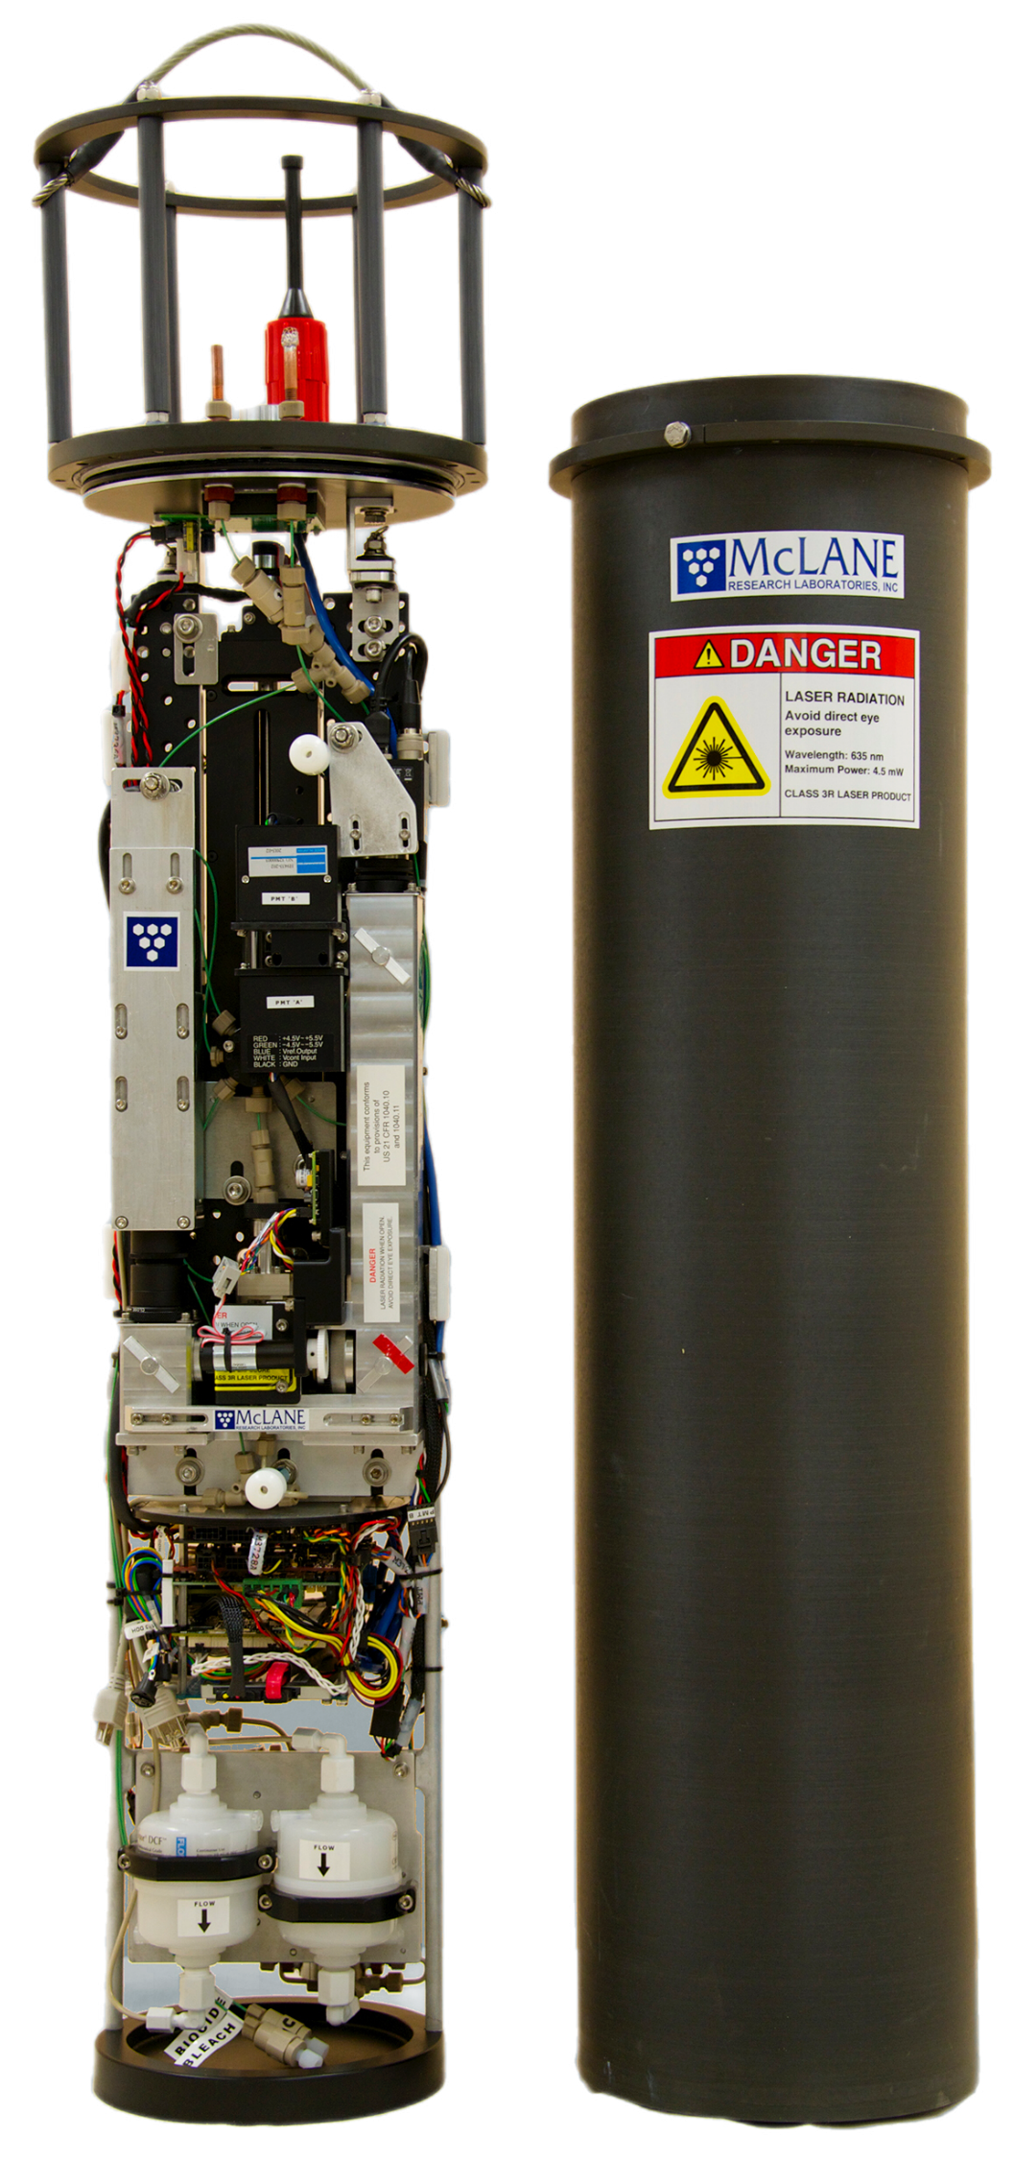
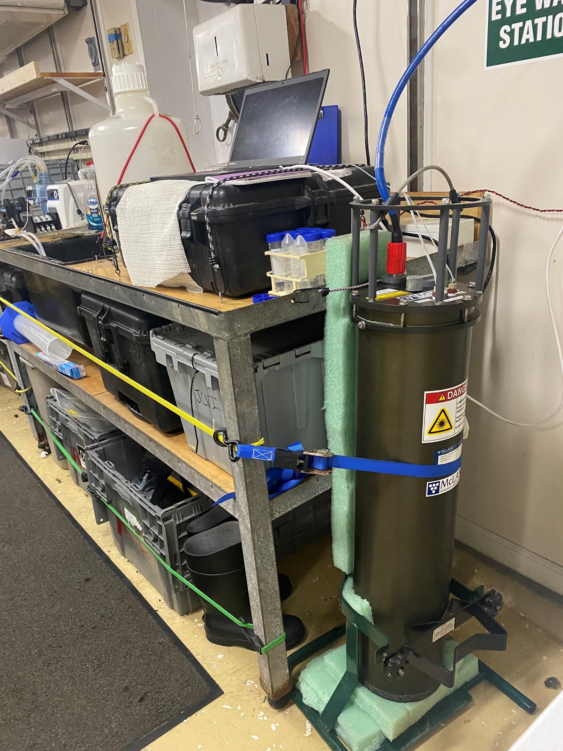
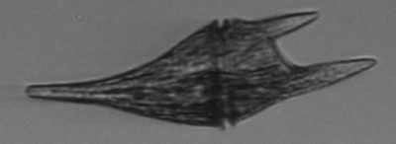
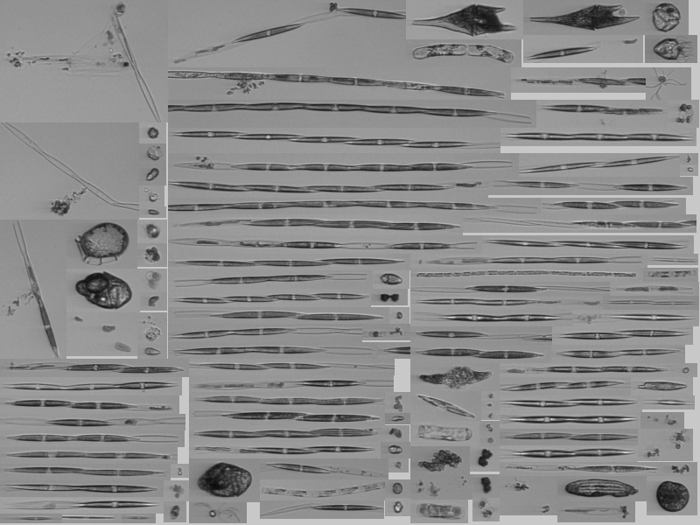
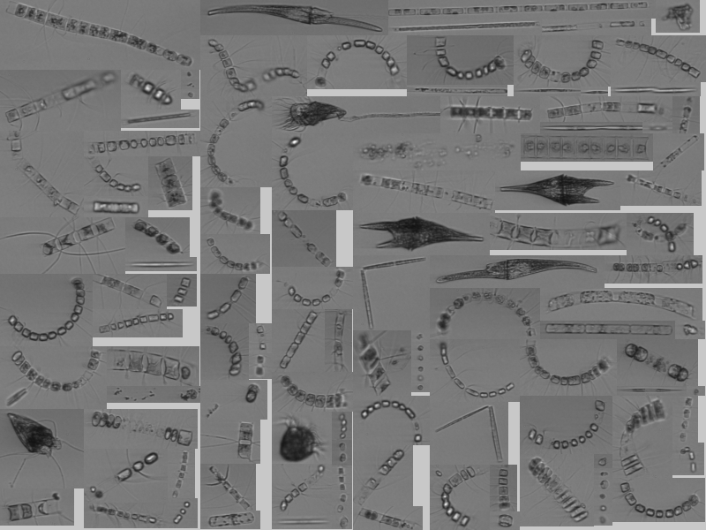
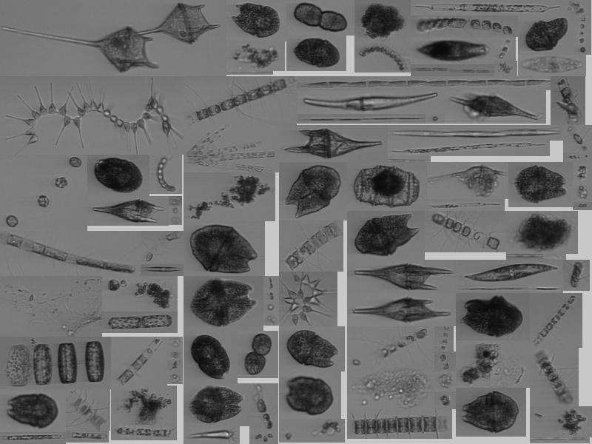
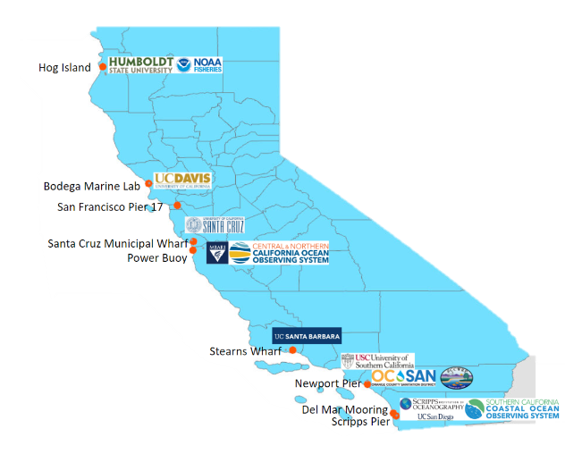
Monitoring Phytoplankton in the California Current with an Automatic Imaging Flow Cytometer
Bryce A. Ellman, Robert H. Lampe, Andrew E. Allen Scripps Institution of Oceanography, University of California San Diego, La Jolla CA 92093 USA J. Craig Venter Institute, La Jolla, CA 92037, USA
Introduction
The Imaging FlowCytobot (IFCB) can automatically capture pictures of eukaryotic phytoplankton within the 8 to 150 µm size range. Up to 30,000 images are generated per hour.
Methods
The IFCB can operate in:
Continuous mode where samples are automatically collected from the ship’s underway system via a diaphragm pump. These samples occur in 5 mL increments every 20-25 minutes.
Discrete mode where samples are collected from the 10 m and chlorophyll maxima depths of the CTD at CalCOFI stations.
Continuous
Sampling
Discrete Sampling
Ocean
Diaphragm pump
Overflowing Collection Bottle
CTD
Collection falcon tube
IFCB
Camera
The IFCB can be secured in the lab for deployment and simple switching between sampling modes.
PMT ‘B’
IFCB Core Components
PMT ‘A’
Pressure Housing
Flow Cell
Computer
Fig 2: The IFCB set up on the summer 2022 CalCOFI on the Bold Horizon.
Fig 3: Schematic of IFCB sampling protocol. Environmental samples are collected and delivered to the unit via the underway system or CTD. Key components identified include the camera and photomultiplier (PMT) B (chlorophyll detection), and the computer.
Fig 1: Images captured by the IFCB on the fall 2022 CalCOFI cruise (not to scale).
Results
The IFCB California coastal network is growing, and data are becoming available to public through an online IFCB dashboard (https://ifcb.caloos.org/).
Continuous operation detected a harmful algal bloom dominated by Pseudo-nitzschia during the 2022 Summer Cruise.
Combined with the molecular data from the NOAA-CalCOFI Ocean Genomics (NCOG) project, the IFCB data will provide new insights into the phytoplankton community structure off the coast of California.
Fig 5: Mosaic images captured by the IFCB on the fall 2022 CalCOFI Images are compiled live from the surrounding waters and arranged on the IFCB dashboard.
The IFCB was deployed on 3 CalCOFI cruises in 2022 and will continue to be incorporated into the CalCOFI time series.
Fig 4: Mosaic image including Pseudo-nitzschia chains from the IFCB dashboard.
Fig 6: Map of deployed IFCBs in California. Adapted from the SCCOOS website (https://sccoos.org/ifcb/).

