Slide 1
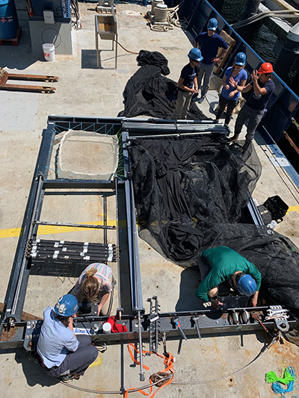
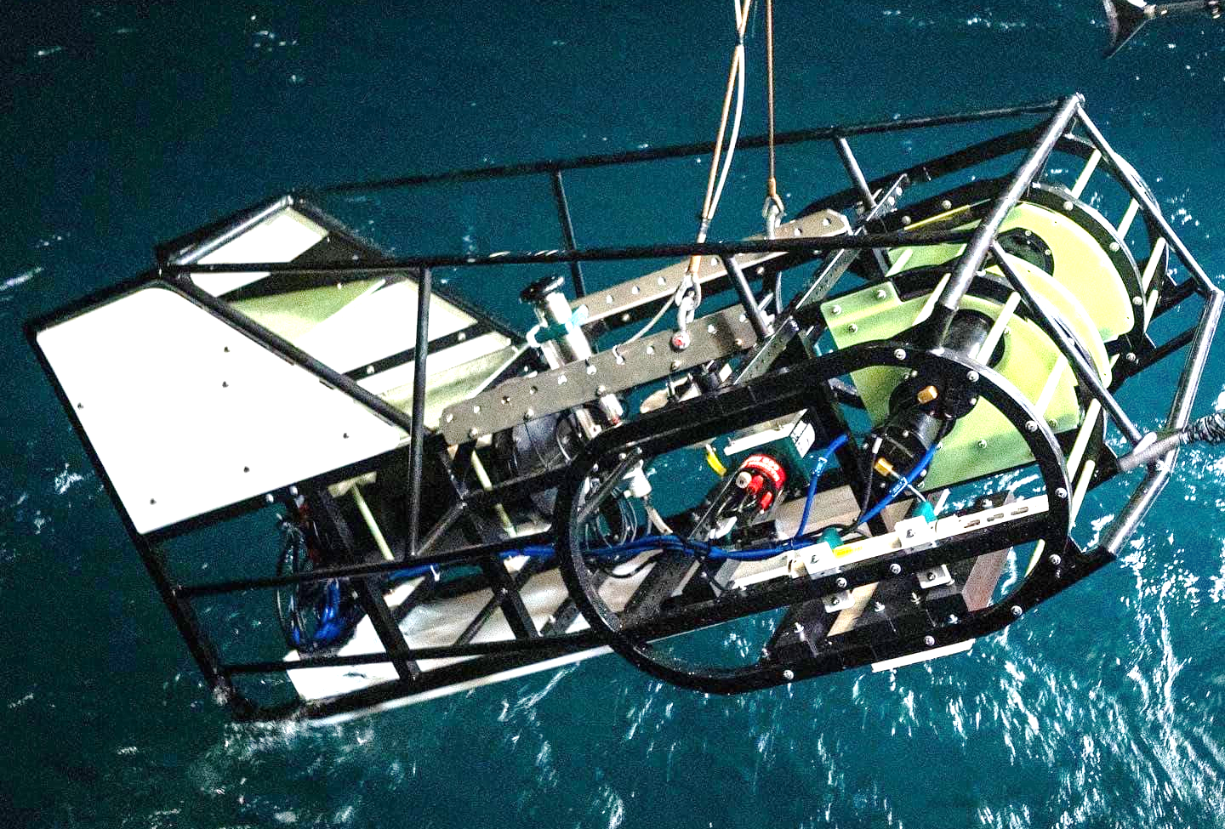
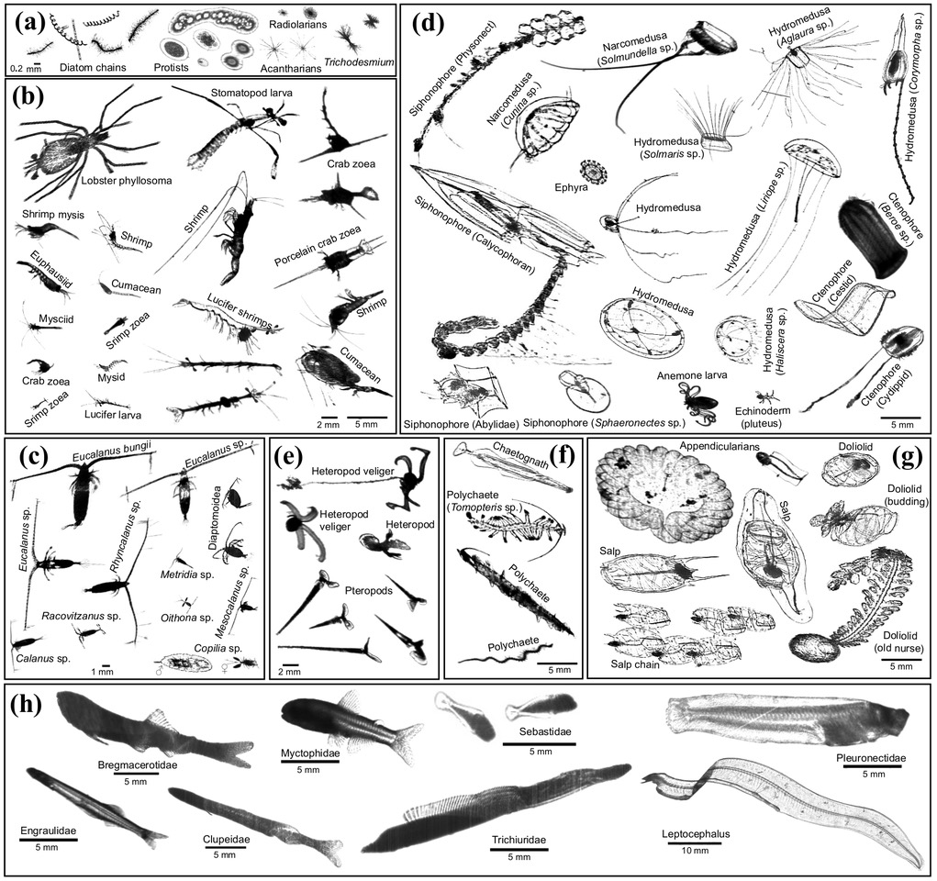
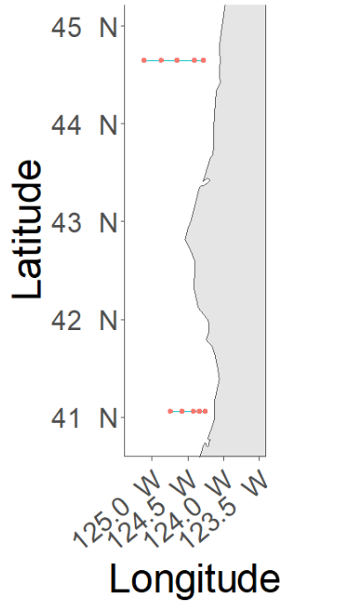
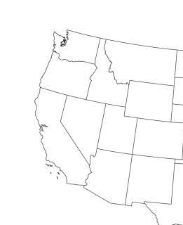

Modeling larval northern anchovy (Engraulis mordax) abundance distributions using fine-resolution imagery data
Luke A. Bobay, Moritz S. Schmid, Robert K. Cowen, Su Sponaugle
Plankton Ecology Laboratory, Hatfield Marine Science Center, Oregon State University
Motivation
Modeling anchovy abundance distributions will aid in anticipation of climate change effects on populations
Models must adequately capture mechanistic drivers that underpin response to environment
Larval anchovy abundance distributions are difficult to predict under novel environmental conditions¹
Fine-scale abundance data may allow more accurate characterization of mechanistic drivers of abundance
Results
CV RF r = 0.35, OOB RF r = 0.36
Depth allowed greatest reduction in node impurities (Fig. 5)
RF was more likely to predict high anchovy abundance at:
  Shallow depths
  High dissolved oxygen
  High chlorophyll a
  Extreme salinities
  High temperatures
  Offshore and extreme
  inshore locations
Increase in node purity
Fig. 5. Variable importance plot of predictors included in model fit to randomly selected 75% of ISIIS larval anchovy abundance observations. Bars indicate the total increase in node purity (Gini index) averaged across all trees for each predictor.
Depth (m)
Oxygen (mL/L)
Fig. 2. The In Situ Ichthyoplankton Imaging System (ISIIS), which uses two shadowgraph cameras and environmental sensors to measure fine-scale plankton abundance and physical parameters.
Fig. 1. Coupled 1-m² and 4-m² Multiple Opening/Closing Net and Environmental Sensing System (MOCNESS)
Fig. 3. Clupeiformes larvae imaged by ISIIS, which cannot be distinguished to species in ISIIS images.
Chlorophyll (mg/L)
Salinity
Data Collection
Winter and summer 2018–2019
MOCNESS to collect larvae (25-m depth strata)
In Situ Ichthyoplankton Imaging System (ISIIS) to collect fine-scale (1-m) larval clupeiform abundance in top 100 m across 17 transects (>120 km each)
OR
Temperature (°C)
Longitude (°)
Fig. 4. Map of MOCNESS stations (red) and ISIIS transects (blue) off Newport, OR and Trinidad Head, CA.
CA
Fig. 6. Partial effect plots for a subset of predictors included in RF fit to randomly selected 75% of ISIIS larval anchovy abundance observations. Hash marks indicate deciles of predictors. Note: Y-axis scales differ among plots.
Conclusions and Future Directions
Similar performance of CV and OOB RFs suggest negligible influence of autocorrelation on model performance
Partial effect plots (Fig. 6) support hypothesized effects of most important predictors (e.g., depth, oxygen, chlorophyll)
  Unexpected effect of salinity
Low predictive performance may indicate that other ecological factors (e.g., currents, predators) are also important
Time lags may obscure relationships between larval anchovy abundance and environmental conditions
Zero inflation may be addressed using a two-step model
Other modeling frameworks (e.g., SDMTMV) may be useful
Data Analysis
Use MOCNESS to distinguish between ISIIS clupeiform larvae
Separate random forests (RFs) were fit to summer 2019 MOCNESS anchovy and sardine abundance data
Predictors: temperature, salinity, depth, latitude, longitude
Applied ratio of predicted anchovy to sardine abundance during co-occurrence to ISIIS clupeiform abundance
Predict ISIIS larval anchovy abundance
RF fit to random 75% of ISIIS larval anchovy (corrected clupeiform) abundance data
  Out-of-bag (OOB) testing to assess predictive performance
4-fold spatially and temporally blocked cross-validation on withheld 25% of data
  Assess influence of autocorrelation on model performance
Predictors: temperature, salinity, chlorophyll a, dissolved oxygen, depth, latitude, longitude, season, year
Acknowledgements
We thank the crews of R/V Sikuliaq, R/V Sally Ride, and R/V Atlantis for their professionalism at sea.
Funding provided by the National Science Foundation, Award Number 1737399.
Reference
Muhling, B. A., et al. 2020. Predictability of species distributions deteriorates
under novel environmental conditions in the California Current system. Front. Mar. Sci. 7:589.

